Slide 1
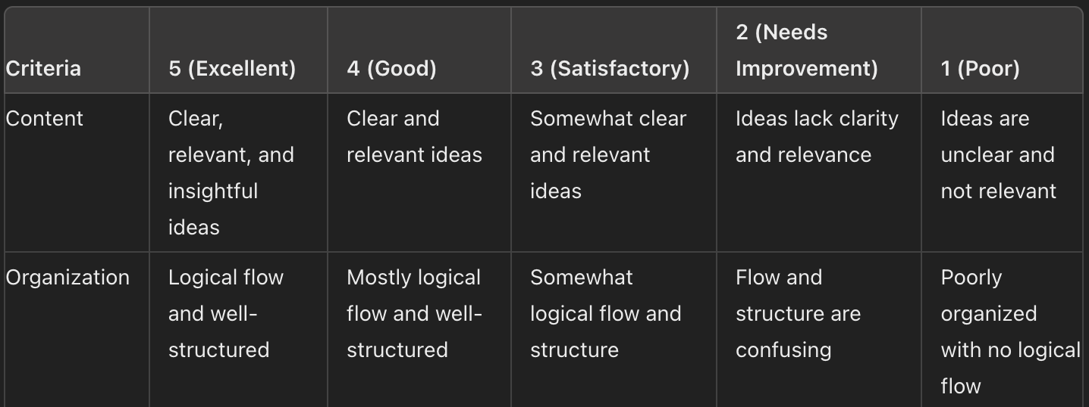
Descriptive Rubrics
Example :
Pros : - Detailed Feedback
- Consistency
- Transparency
Cons: - Time consuming

Slide 2
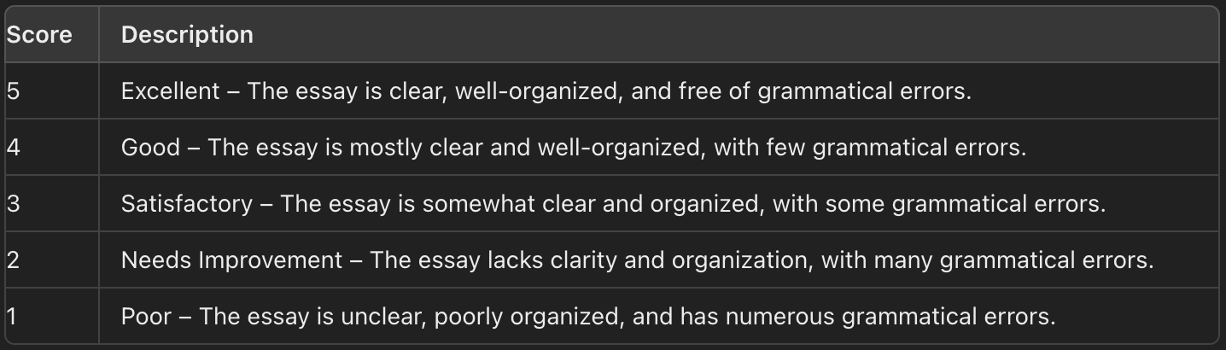
Holistic Rubrics
Example :
Pros : - Faster
-Simplier
Cons : - Less Detailed Feedback
- More subjectivity

Slide 3
Papers

Slide 4
Automated Evaluation of Written Discourse Coherence Using GPT-4
1
500 responses : - 20 were doubled rated collaboratively for standardization
- 80 were rated independently by pairs of raters to assess interrater agreement (k=0.93)
- 420 responses were rated by a single rater each.
They used holistics rubrics and a rating of 0 was also given to blank or bad-faith responses in which the test taker did not attempt to respond to the prompt.

Slide 5
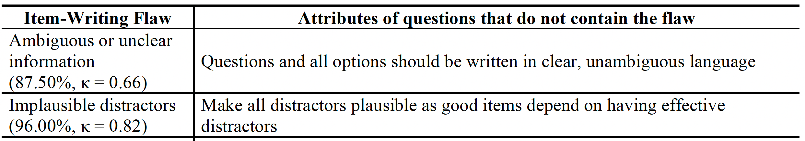
Assessing the Quality of Multiple-Choice Questions Using GPT-4 and Rule-Based Methods
2
200 answers evaluated twice by two different raters and the they compute the interrater agreement for each
criteria they evaluated. Kappa between 0.66 and 1 across all criteria.
They use a descriptive rubrics method describing whether or not the answers where having a certain flaw or not

Slide 6
Examining LLM Prompting Strategies for Automatic Evaluation of Learner-Created Computational Artifacts
3
75 results to assess, two raters, kappa = 0.82
A descriptive rubric based on a 1-4 scale
After resolving any discrepancies through discussion, one grader proceeded to grade the remaining artifacts.

Slide 7
A Confederacy of Models: a Comprehensive Evaluation of LLMs on Creative Writing
4
Descriptive rubric based on 10 criterias from a university textbook on creative writing
10 raters, evaluating the 65 answers, each raters had a batch and they made sure each answer was rated two times for the inter rater agreement (kappa = 0.48 : they describe it as moderate agreement)

Slide 8
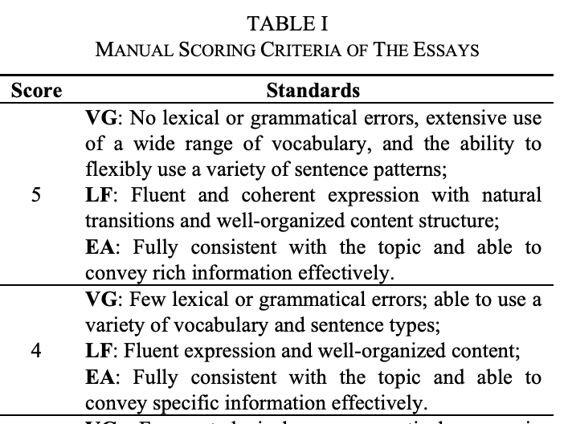
Automated Essay Scoring and Revising Based on Open-Source Large Language Models
5
Descriptive rubric, each score can be achieved according to certain criterias
Kappa between 0.128 and 0.660 according to the LLMs used

